Slide 1
Presentations
1. Introduction to the TeenTech Awards
2. How to do effective research
3. The Data Science Award

Slide 2
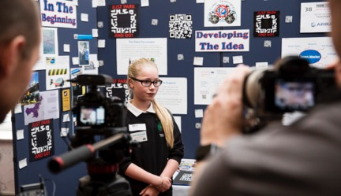
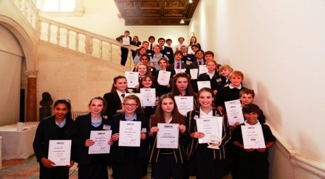
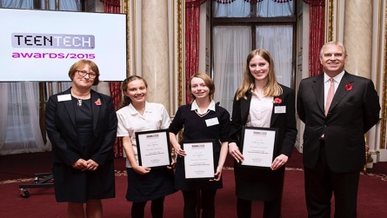

Slide 3
Could you make life better, simpler,
safer or more fun?

Slide 4
Do you want to win £1000 and be invited to Buckingham Palace?

Slide 5
11-16? Choose from these categories
Health , Design and Construction, Education, Energy and Environment, Food, Music , Media and Entertainment, Future of Business,
Fashion and Retail, Safety and Cyber Security
Wearable Technology , Data Science
AND win prizes for
Digital Skills, Manufacturing ,Research

Slide 6
17-19 ? Choose from these categories
Best Concept
Best Model or Prototype
Best Research project
Data Science
Future of Business (new)

Slide 7
Introducing the Data Science Award!
This prize in the TeenTech Awards is for the team who demonstrates the best use and analysis of data.
Gathering and/or interpreting data may spark new ideas that no-one else has thought about
The Award is sponsored by Accenture and we have lots of resources and specialist mentors to support you

Slide 8
Teams of up to three students
aged 11- 16, 17-19
Notes:
The awards are open to students aged 11-16 and 17-19 and you can work in a group of up to three people. This team entered ‘Wearable technology” with a device to help teenagers eat healthily.

Slide 9
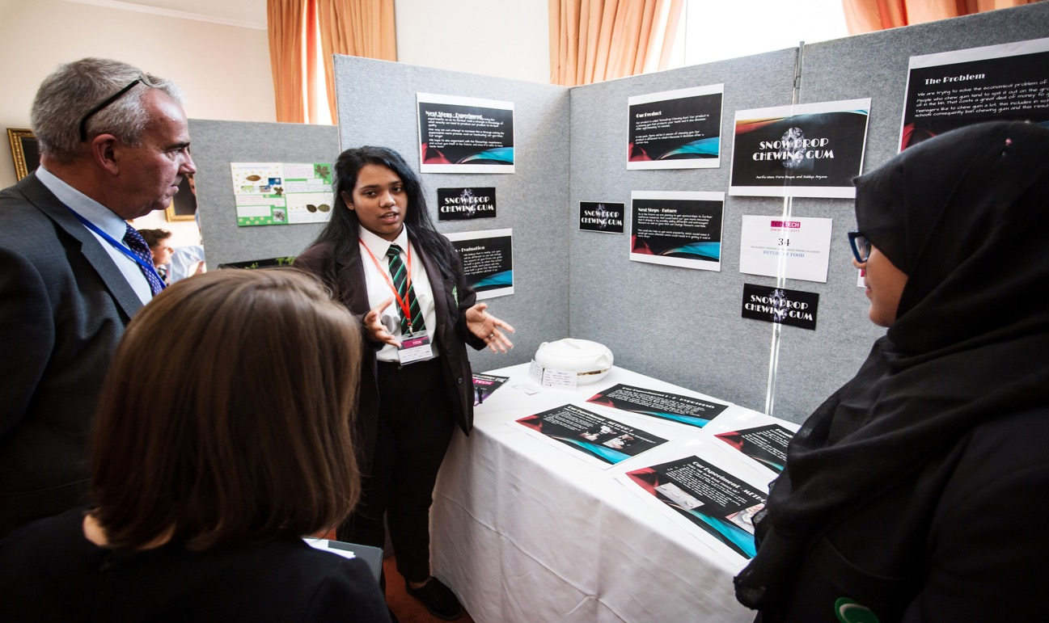
This team tackled the problem of chewing gum on pavements

Slide 10
Or you might choose to enter on your own. This student made car travel more comfortable for people with narcolepsy
Notes:
Or you might choose to enter on your own. This student made car travel more comfortable for people who suffer from narcolepsy

Slide 11
1. Register on the Awards page of our website if you haven’t already done so and we will send you full details www.teentech.com

Slide 12
Ideas Wall
2. Brainstorm
Notes:
You might want to begin by brainstorming lots of ideas – you could set up an ideas wall.

Slide 13
3. Research
Notes:
Once you’ve decided on your idea – do some research to find out more about the category area. We have some terrific resources to help you do this. You can download them from our website.
Remember we also have resources to help you make great use of data – whether you simply decide to do a survey or do a focussed project for the new Data Science category!

Slide 14
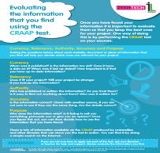
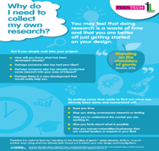
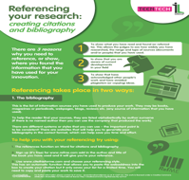
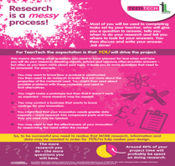
We have some great downloadable resources to help you deliver strong research
Notes:
We have a great set of resources to help you plan your research. It’s worth reading these as they’ll give you lots of ideas about how to search for information.
And there’s a special award for teams in both age groups who do the best research

Slide 15
3. Get expert help and advice from BBC, Atkins and Accenture and lots of exciting companies
Notes:
And you don’t have to do this on your own. TeenTech can put you in touch with lots of companies and universities who are happy to help. Companies like Airbus …

Slide 16
25 Universities offer help too and some run special ‘TeenTech Innovation Sessions’
Notes:
….or Universities ….who also run ‘Innovation sessions’ to help you develop your project.

Slide 17
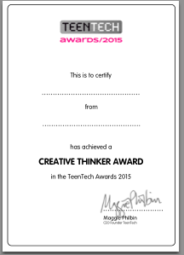
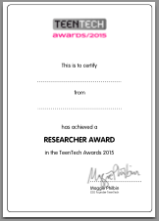
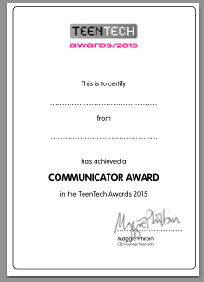
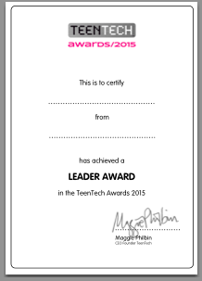
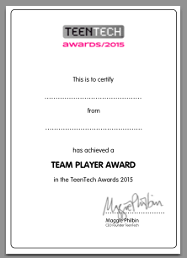
Earn certificates for different parts of your project work
Notes:
Download the certificates to reward hard work along the way!

Slide 18
4. Upload your ‘Innovation Log’ by March 28th 2018
Notes:
Once you’ve finished your project – you need to upload it to the TeenTech website. You have until the end of the Spring term to do this. TeenTech ask you to keep a log of your work and like to see all your rough notes. You can share all the difficult moments as well as the good ones …

Slide 19
Finalists announced at the beginning of the Summer Term
Notes:
The final judging takes place at the Royal Society. TeenTech will tell us if you have a place at the beginning of the Summer Term so you have a few weeks to do more work on it before the final which will be in June !

Slide 20
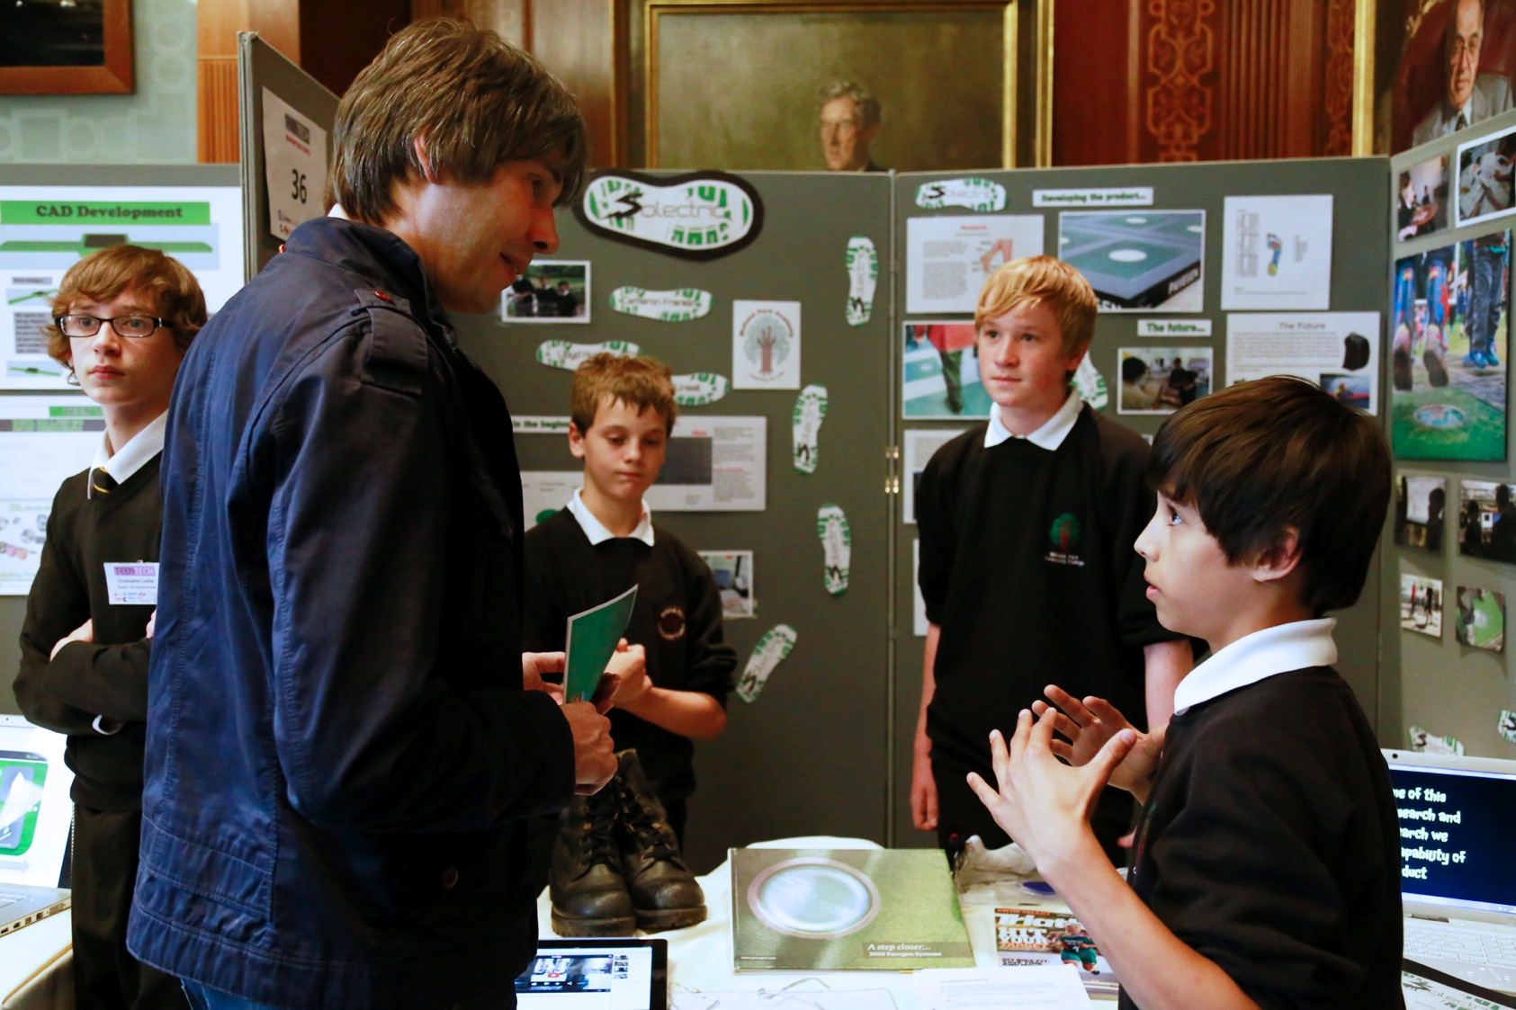
Share your ideas with top people in science and technology at the final!
Notes:
The top three ideas in each category go through to the final .Lots of tech celebrities come to chat to you and find out more about your ideas. It’s a really fun day!

Slide 21
These girls from Greenock won the Manufacturing Category with their idea for a product which ends the struggle of speading butter without tearing the bread
Notes:
These girls from Greenock won the Manufacturing Category with their idea for a product which ends the struggle of speading butter without tearing the bread

Slide 22
You never know who might want to hear about your idea!

Slide 23
Everyone is always impressed by the imagination of the students …this team redesigned their school!
Notes:
Everyone is always impressed by the imagination of the students …this team redesigned their school!

Slide 24
The biggest prize is what every single student learns about themselves along the way.
Notes:
The winning teams in each category take home £1000 for their school and some fabulous prizes for the students. The biggest prize is what the students have learnt about themselves along the way.

Slide 25
And it’s an exciting moment to discover that the next step will be …
Notes:
And it’s an exciting moment to discover that the next step will be …

Slide 26
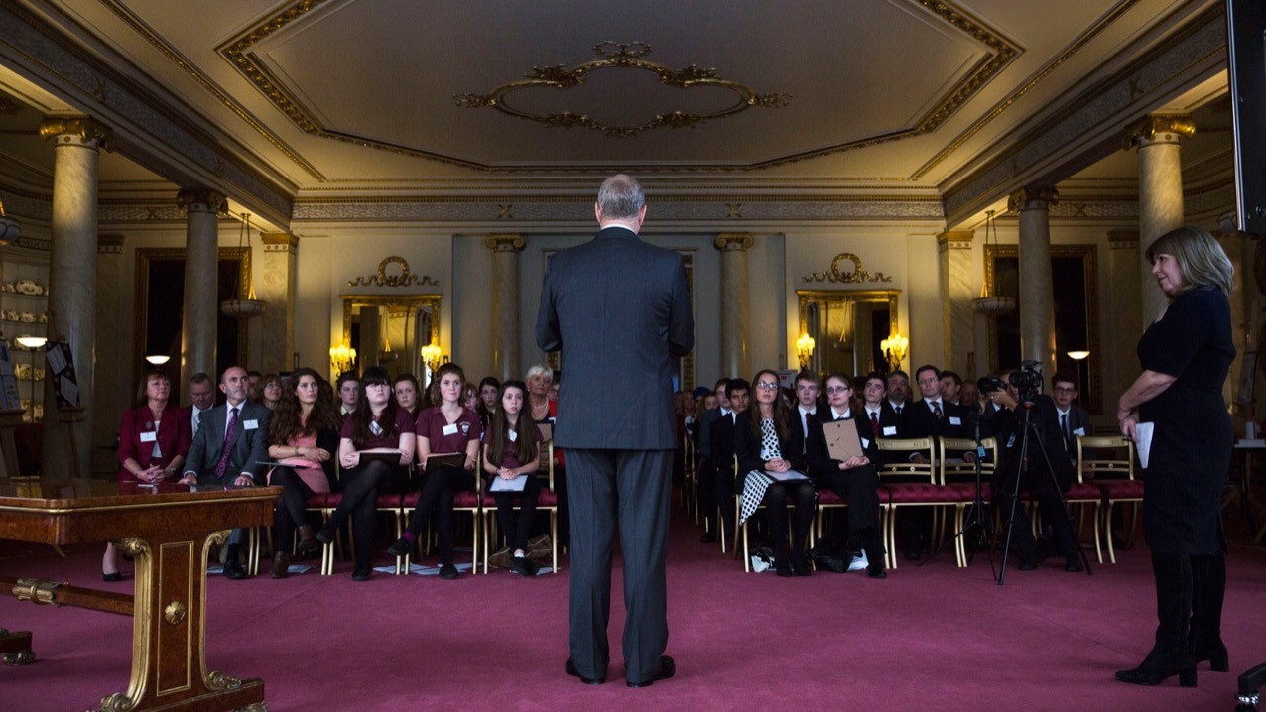
.. a very special ceremony for the winning teams at Buckingham Palace with our patron HRH Duke of York,KG
Notes:
.. a very special ceremony for the winning teams at Buckingham Palace with our patron HRH Duke of York

Slide 27
Ready to change the world?
Who’ll be in your team?

Slide 28
Key Dates
Register your team before the end of the Autumn term if you haven’t already done so . You don’t need to have started work.
If you intend to enter Data Science-let us know so we can assign a mentor now
Once you’ve mapped out your idea and are ready for expert feedback –let us know so we can connect you with specialist help.
Submit your project online by the end of the Spring term
Finalists announced beginning of Summer term
Final June 2020

Slide 29
Great projects begin with great research
Our resources help students research effectively.
Following the guidelines mean they can also be considered for the Research and Information Literacy Award

Slide 30
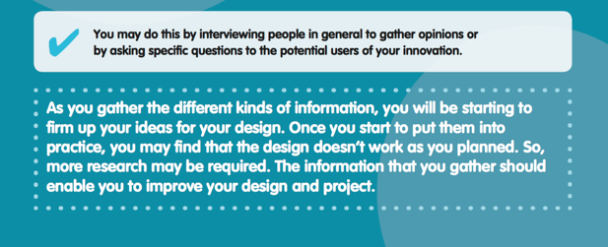

Slide 31
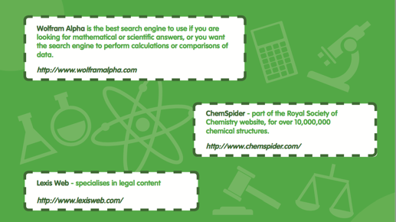
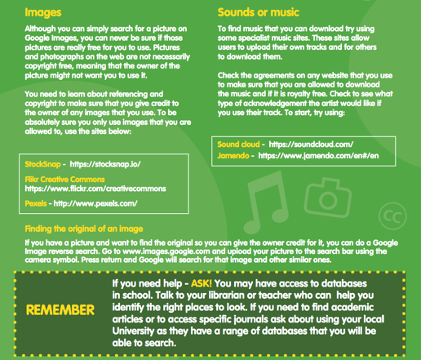

Slide 33
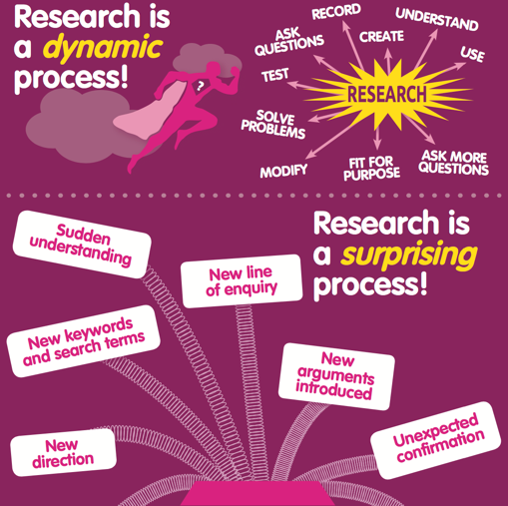
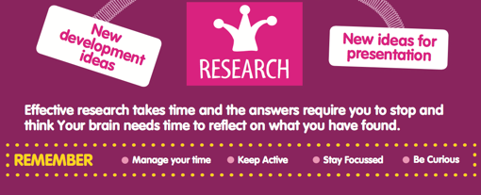
“

Slide 36
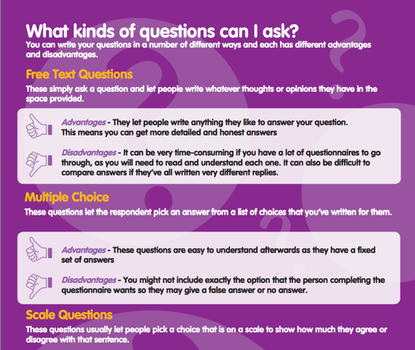
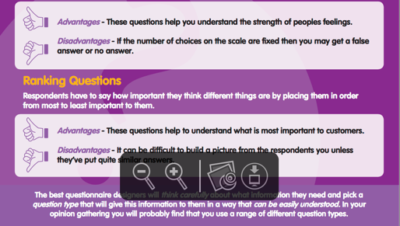

Slide 38
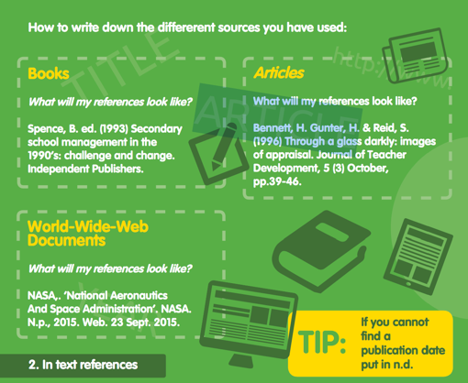
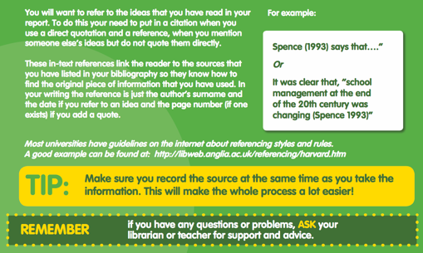

Slide 39
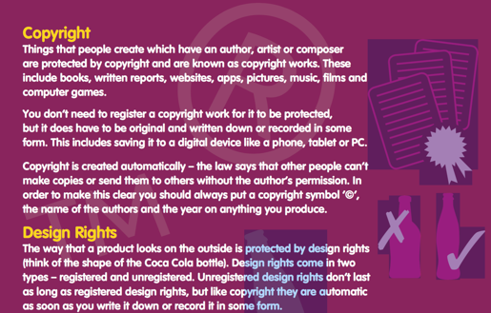

Slide 41
The Data Science Award
sponsored by Accenture
Teacher resources

Slide 42
Data Science now has its own category
From 2017/8 there will be a new prize in the TeenTech Awards for the team who demonstrates the best use and analysis of data.
The prize is sponsored by Accenture and the Data Skills Taskforce
Teams can either
Enter one of our set challenges and develop projects based on data sets which we will provide
OR
Use existing sets of secondary data within their own project
And / OR
Gather their own primary data within their own project

Slide 43
Use of data will be included in judging criteria across all TeenTech Awards
Originality of idea
Quality of research methods
Clarity of Idea
Use of data
Understanding of potential market
Use of industry experts
International Collaboration
Skill and thoroughness
Is it doable?
What did the team learn?

Slide 44
You don’t have to do this on your own! We’re here to help ☺
Shifath
I use Data Science to train computers to recognise thousands of objects within images/videos and making statistical predictions about the future.
Loizos
Data Science is a lot of fun because it allows me to investigate crimes like Sherlock Holmes and train computers to read people’s brains like Professor X in X men.
Hiren
I’m passionate about the various applications of Data Science.
The variety of problems we can solve can range from improving health care through clinical research to putting criminals behind bars.
Susan
As a Data Scientist, my work really changes things – how companies work, how companies treat their customers, how organisations make new products and more.
Noor
Data Science provides an opportunity for me to investigate quirky patterns of behaviour within data, challenges my creative thinking and allows me to learn from super talented people.

Slide 45
What is Data?
Data is a set of values of qualitative or quantitative variables collected for some purpose, usually analysis.
Data is collected and analysed by a huge range of organizations and institutions including businesses (e.g., sales data, revenue, profits), governments (e.g., crime rates, unemployment rates) and non-governmental organizations to make smarter decisions and to build better products.

Slide 46
What difference will effective use of data make to my project?
Projects will be even more convincing than one based only on personal experience or anecdote – though personal experience provides useful understanding and insight
You may change, improve or even discard ideas when you look closely at the data.
Gathering and/or interpreting data may spark new ideas that no-one else has thought about

Slide 47
Digital Forms of Data
Text
Tweeting and Google Search generates enormous amounts of text data which is analysed to improve the Google search engine and personal recommendations
Image
Images on Instagram, Facebook, Snapchat and Pinterest are currently used to training machine learning algorithms for face recognition, object detection, and more.
Video
Your viewing of YouTube, Netflix and Amazon Videos is analysed to make personal recommendations and produce new original content.
Audio
Your listening history on Spotify is analysed to improve the user experience on Spotify and make personal music recommendations.

Slide 48
Warm Up Exercise
Where has data been collected about you this week?
How could that data be used to improve your life or that of others?
If you think about your journey here today, how could data have improved your experience?
How could data have made this room more comfortable today?

Slide 49
Why is an understanding of data important for ALL students ?
Data skills are increasingly important in modern society
Data helps us understand how, what, when and where to innovate
There are many exciting and well paid career opportunities
Data science cuts across all industries from health to transport, entertainment to food
It can help combat issues from rogue landlords to alcohol abuse, modern slavery, fire hazards and problem gambling
So understanding how to collect and analyse data will help in any future career

Slide 50
Advice on getting started …
Pick a topic about which you’re excited, curious or really care. It might be cancer, cats or chemicals.
Decide whether you want to collect your own data, use existing sets or a combination to produce original insights.
If you’re collecting your own data, think carefully about what you want to find out.
Check out the best ways to structure surveys or conduct observations.
Remember – we can put you in touch with a data mentor!

Slide 51
Data sources for your projects
Primary Data: data you collect specifically for the purpose of your project
Secondary Data: data you use within your project but which was originally collected for a different purpose. We will provide a range of data sets for you but you may decide to source your own.

Slide 52
Primary Data Sources 10 tips for creating a survey
Structure: Determine the objective of your survey, the expected number of participants, number of questions/available responses,
Use formatting. Group similar questions to keep your survey logical and focused. Page breaks, page titles and instructions help people understand what you’re asking and why.
Ask often. Using the same question in a series of surveys, or even using the same survey over time, is a good way to build a baseline and measure changes in respondents’ attitudes.
Be brief. Keep questions and surveys as short as possible to keep respondents interested and motivated to complete your survey.
Ease into it. Asking personal or sensitive questions at the beginning can scare people away. Save those questions – if they’re absolutely necessary – for the end.
Stick to specifics. Create survey questions that explore one idea at a time to make sure your respondents can understand what you’re asking. Vague, general, multi-part questions can be confusing and tricky to answer.
Clarify, clarify, clarify. Spell out everything that could be interpreted in more than one way. Make sure you specify whether you’re talking about the way they dress, their eating habits, their preference in music, etc.
Keep it relevant. Make sure that respondents stay focused by only showing them those questions that apply to them. A great way to do this is by using slip logic to eliminate irrelevant questions.
Avoid yes/no questions. Yes/no questions don’t capture people who are on the fence or nuances in people’s opinions – in other words, yes/no questions can’t give you the information you need!
Use words rather than numbers. When designing answer choices, use phrases such as “slightly likely” or “extremely likely” rather than numbers such as “2” or “4” to indicate the degree of preference. These answer choices are easier for people to understand.

Slide 53
Primary Data Sources Resources
How to design a Survey:
https://www.surveysystem.com/sdesign.htm
https://www.surveygizmo.com/survey-blog/designing-surveys/
https://www.smartsurvey.co.uk/articles/10-tips-for-designing-an-effective-online-survey
https://zapier.com/learn/forms-surveys/design-analyze-survey/

Slide 54
Primary Data Sources Simple Example
Objective: Does the number of hours spent on homework improve test scores in three subjects?
Which subject do you enjoy the most at school?
Math
Science
English
What score did you get in your latest test in the following subjects?
Math
Science
English
How many hours a day do you spend doing homework in a day?
0 to 1 hour
2 to 3 hours
4 to 5 hours
more than 5 hours
How many hours do you spend watching TV in a day?
0 to 1 hour
2 to 3 hours
4 to 5 hours
more than 5 hours

Slide 55
Secondary Dataset Data you use within your project but which was originally collected for a different purpose
Financial:
https://www.data.gov/finance/
https://finances.worldbank.org/all-datasets
https://data.gov.uk/dataset/financial_statistics
Sports:
https://datahub.io/dataset?tags=sports
https://knoema.com/atlas/topics/Sports/datasets
Transport:
https://data.gov.uk/data/search?theme-primary=Transport
Health:
http://www.datasciencecentral.com/profiles/blogs/10-great-healthcare-data-sets
http://www.content.digital.nhs.uk/datasets
https://data.gov.uk/data/search?theme-primary=Health
Agriculture:
https://data.gov.uk/dataset/agriculture_in_the_united_kingdom
https://data.gov.uk/dataset/farming_statistics
https://www.gov.uk/government/statistical-data-sets/agriculture-in-the-united-kingdom
https://datahub.io/dataset?tags=agriculture
Media:
https://archive.ics.uci.edu/ml/datasets/Buzz+in+social+media+
Telecommunications:
https://data.gov.uk/dataset/telecommunications-market-quarterly-data-tables
Other Data Sources:
https://www.kaggle.com/datasets
https://www.reddit.com/r/datasets/
http://www.kdnuggets.com/datasets/index.html
https://www.springboard.com/blog/free-public-data-sets-data-science-project/
http://lib.stat.cmu.edu/datasets/
http://cooldatasets.com/

Slide 56
One option is to follow a set Challenge
Students should choose one challenge from the three listed
Let us know if you want to do this
We will provide:
Data sets
An example of how to interpret a data set
A suggested step by step approach
Mentors to support students
Links to further resources
Links to inspiring Data Scientists on social media

Slide 57
Challenge 1 Does every picture tell a story?

Slide 58
Challenge 1 – Is there a formula for a box office smash?
Can we predict how successful a movie will be before it is released in cinema? Are there ways to make movie promo posters really appeal?
We will give you information on 5000+ movies spanning 100 years
28 variables – such as title, colour, actors, number of faces on the poster, Facebook likes etc.
Using this data, you will advise the studio on the best ingredients for their promo posters.

Slide 59
Challenge 1 – The Approach
1. Explore
What can you learn from the dataset? What trends can you see?
Do the best ranked movies (IMDB score) have anything in common?
Do the most popular movies (Facebook Likes) have anything in common?
2. Compare/Analysis
Given that thousands of movies are produced each year, is there a better way for us to predict the greatness of movie without relying on critics or our own instincts?
• Does the number of human faces in a movie poster relate to the movie rating?
• What are are the most important factors for a movie to gain a high IMDB score?
3. Summary
• If given the opportunity, what additional pieces of information/attributes would you have
captured for this study? Why?
• Based on what you have learnt from this data analysis exercise, how would you advise a film
studio about movie posters.

Slide 60
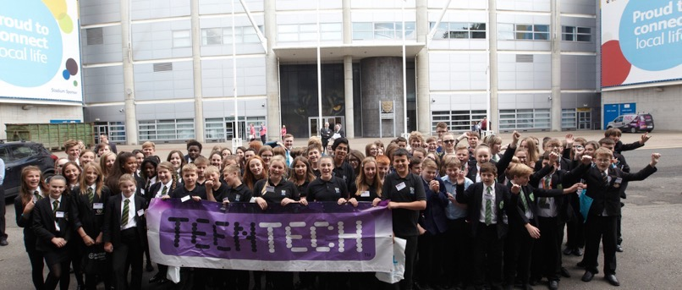
Challenge 2 You are experts in Education

Slide 61
Challenge 2 - What changes would you make to Education Policy?
We will give you:
Data on student achievement in secondary education of two schools for performance in two distinct subjects: Mathematics and Portuguese language
Variables such as student grades, demographic, social , school related features
Your challenge is to use the data to suggest changes in policy which would benefit schools and students

Slide 62
Challenge 2 – The approach
1.Explore
• What can you infer from this dataset.
• Do the schools have anything in common?
• Do the high performers in each class have something in common?
2.Compare/Analysis
• Compare the performance of the two Schools in their performance achievement
in Mathematics. What did you learn?
• Repeat the exercise for Portuguese?
• Investigate which are the most important attributes impacting the final grade?
3. Summary
• If given the opportunity, what additional pieces of information/attributes would
you have captured for this study? Why?
• Based on what you have learnt from this data analysis exercise, what changes would you suggest the government makes to its Education policies?

Slide 63
Challenge 3 Can you help the USA reduce violent crime?

Slide 64
Challenge 3 - What changes would reduce violent crime?
We will give you:
Socio-economic data from the 1990 US Census, law enforcement data from the 1990 US LEMAS survey, and crime data from the 1995 FBI UCR.
The variables will include State, Income, Community, Race,
Income, Age, Education, Housing, Police, etc.
The Challenge is to analyse the data and advise the US government on ways to reduce violent crimes?

Slide 65
Challenge 3 – The Approach
Explore
What can you infer from this dataset.
Compare each State against one another? What did you learn?
Compare/Analysis
Investigate which are the most important attributes impacting the total number
of violent crimes?
Summary
• If given the opportunity, what additional pieces of information/attributes would you have captured for this study? Why?
• Based on what you have learnt from this data analysis exercise, how would you advise the US government on reducing violent crimes?

Slide 66
Data Science Theory Learning The Basics of Data Science
Exploratory Data Analysis. The essential exploratory techniques for summarizing data.
Data Visualization. Learn in-depth concepts, methods, and applications of pattern discovery in data mining.
Getting and Cleaning Data. It will also cover the basics of data cleaning and how to make data “tidy”. Tidy data dramatically speed downstream data analysis tasks.
Intro to Descriptive Statistics. Teach you the basic concepts used to analyze and describe outcomes from data.
Intro to Statistics. Introduce techniques for visualizing relationships in data and extracting meaning from data.
Intro to Data Science. This will give you the opportunity to sample and apply the basic techniques of data science.
Statistical Thinking for Data Science and Analytics. Learn how statistics plays a central role in the data science approach.

Slide 67
Data Science Toolkit Analysing data using Excel, R and Python.
R Programming. Learn how to program in R and how to use R for effective data analysis
The R Programming Environment. A rigorous introduction to the R programming language, with a particular focus on using R for software development in a data science setting.
Intro to Data Analysis (uses Python). Introduction to the world of data analysis.
Data Analysis with R (in Collaboration with R). Exploratory data analysis is an approach for summarizing and visualizing the important characteristics of a data set.
Python. Learn the basics, and move on to create stunning visualizations.
Learn SQL. Learn how to manipulate data stored in a database.
Introduction to Python for Data Science. Learn the basics to create stunning visualizations.
Introduction to R for Data Science. Learn the R programming language.
Analyzing and Visualizing Data with Excel. Gather, analyze and visualize data.
Essential Statistics for Data Analysis using Excel. Gain a solid understanding of statistics.

Slide 68
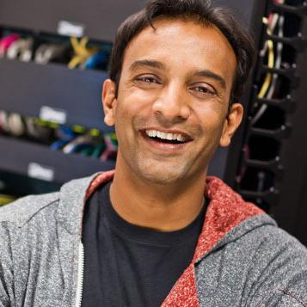
Twitter Learn from the Best
Learn and keep up to date by following some of the most influential Data Scientists on Twitter.
Some of these include:
DJ Patil and Jeff Hammerbacher (the duo who coined the term “Data Scientist”)
Gregory Piatetsky (President of KDNuggets)
Peter Skomoroch (ex LinkedIn Data Scientist)
Hilary Mason (founder of Fast Forward Labs)
and many more . . .
Hilary Mason
Peter Skomoroch
Gregory Piatetsky
DJ Patil
Jeff Hammerbacher
Notes:
http://bigdata-madesimple.com/33-most-noted-data-scientists-on-twitter/

Slide 69
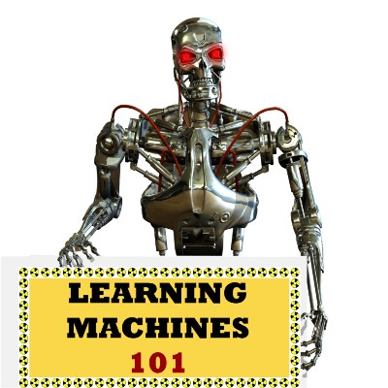
Podcasts Fun Listening
A great starting point on some of the basics of data science and machine learning.
Hosted by Katie Malone and Ben Jaffe, this weekly podcast covers diverse topics in data science and machine learning make complex topics extremely accessible.
Each week, hosts Chris Albon and Jonathon Morgan, both experienced technologists and data scientists, talk about the latest news in data science.
Data Stories is a little more focused on data visualization than data science, but there is often some interesting overlap between the topics.
Every other week, hosts Katherine Gorman and Ryan Adams speak with a guest about their work, and news stories related to machine learning.
Billing itself as “A Gentle Introduction to Artificial Intelligence and Machine Learning”, this podcast can still get quite technical and complex.
Notes:
https://medium.com/swlh/the-7-best-data-science-and-machine-learning-podcasts-e8f0d5a4a419

Slide 70
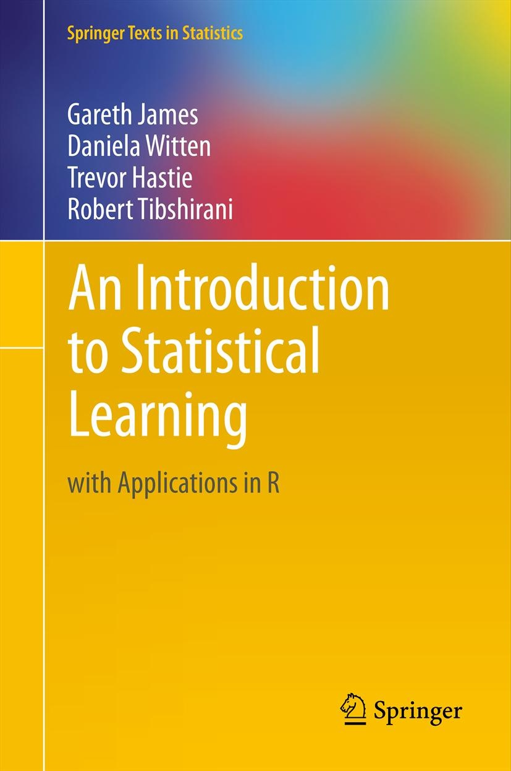
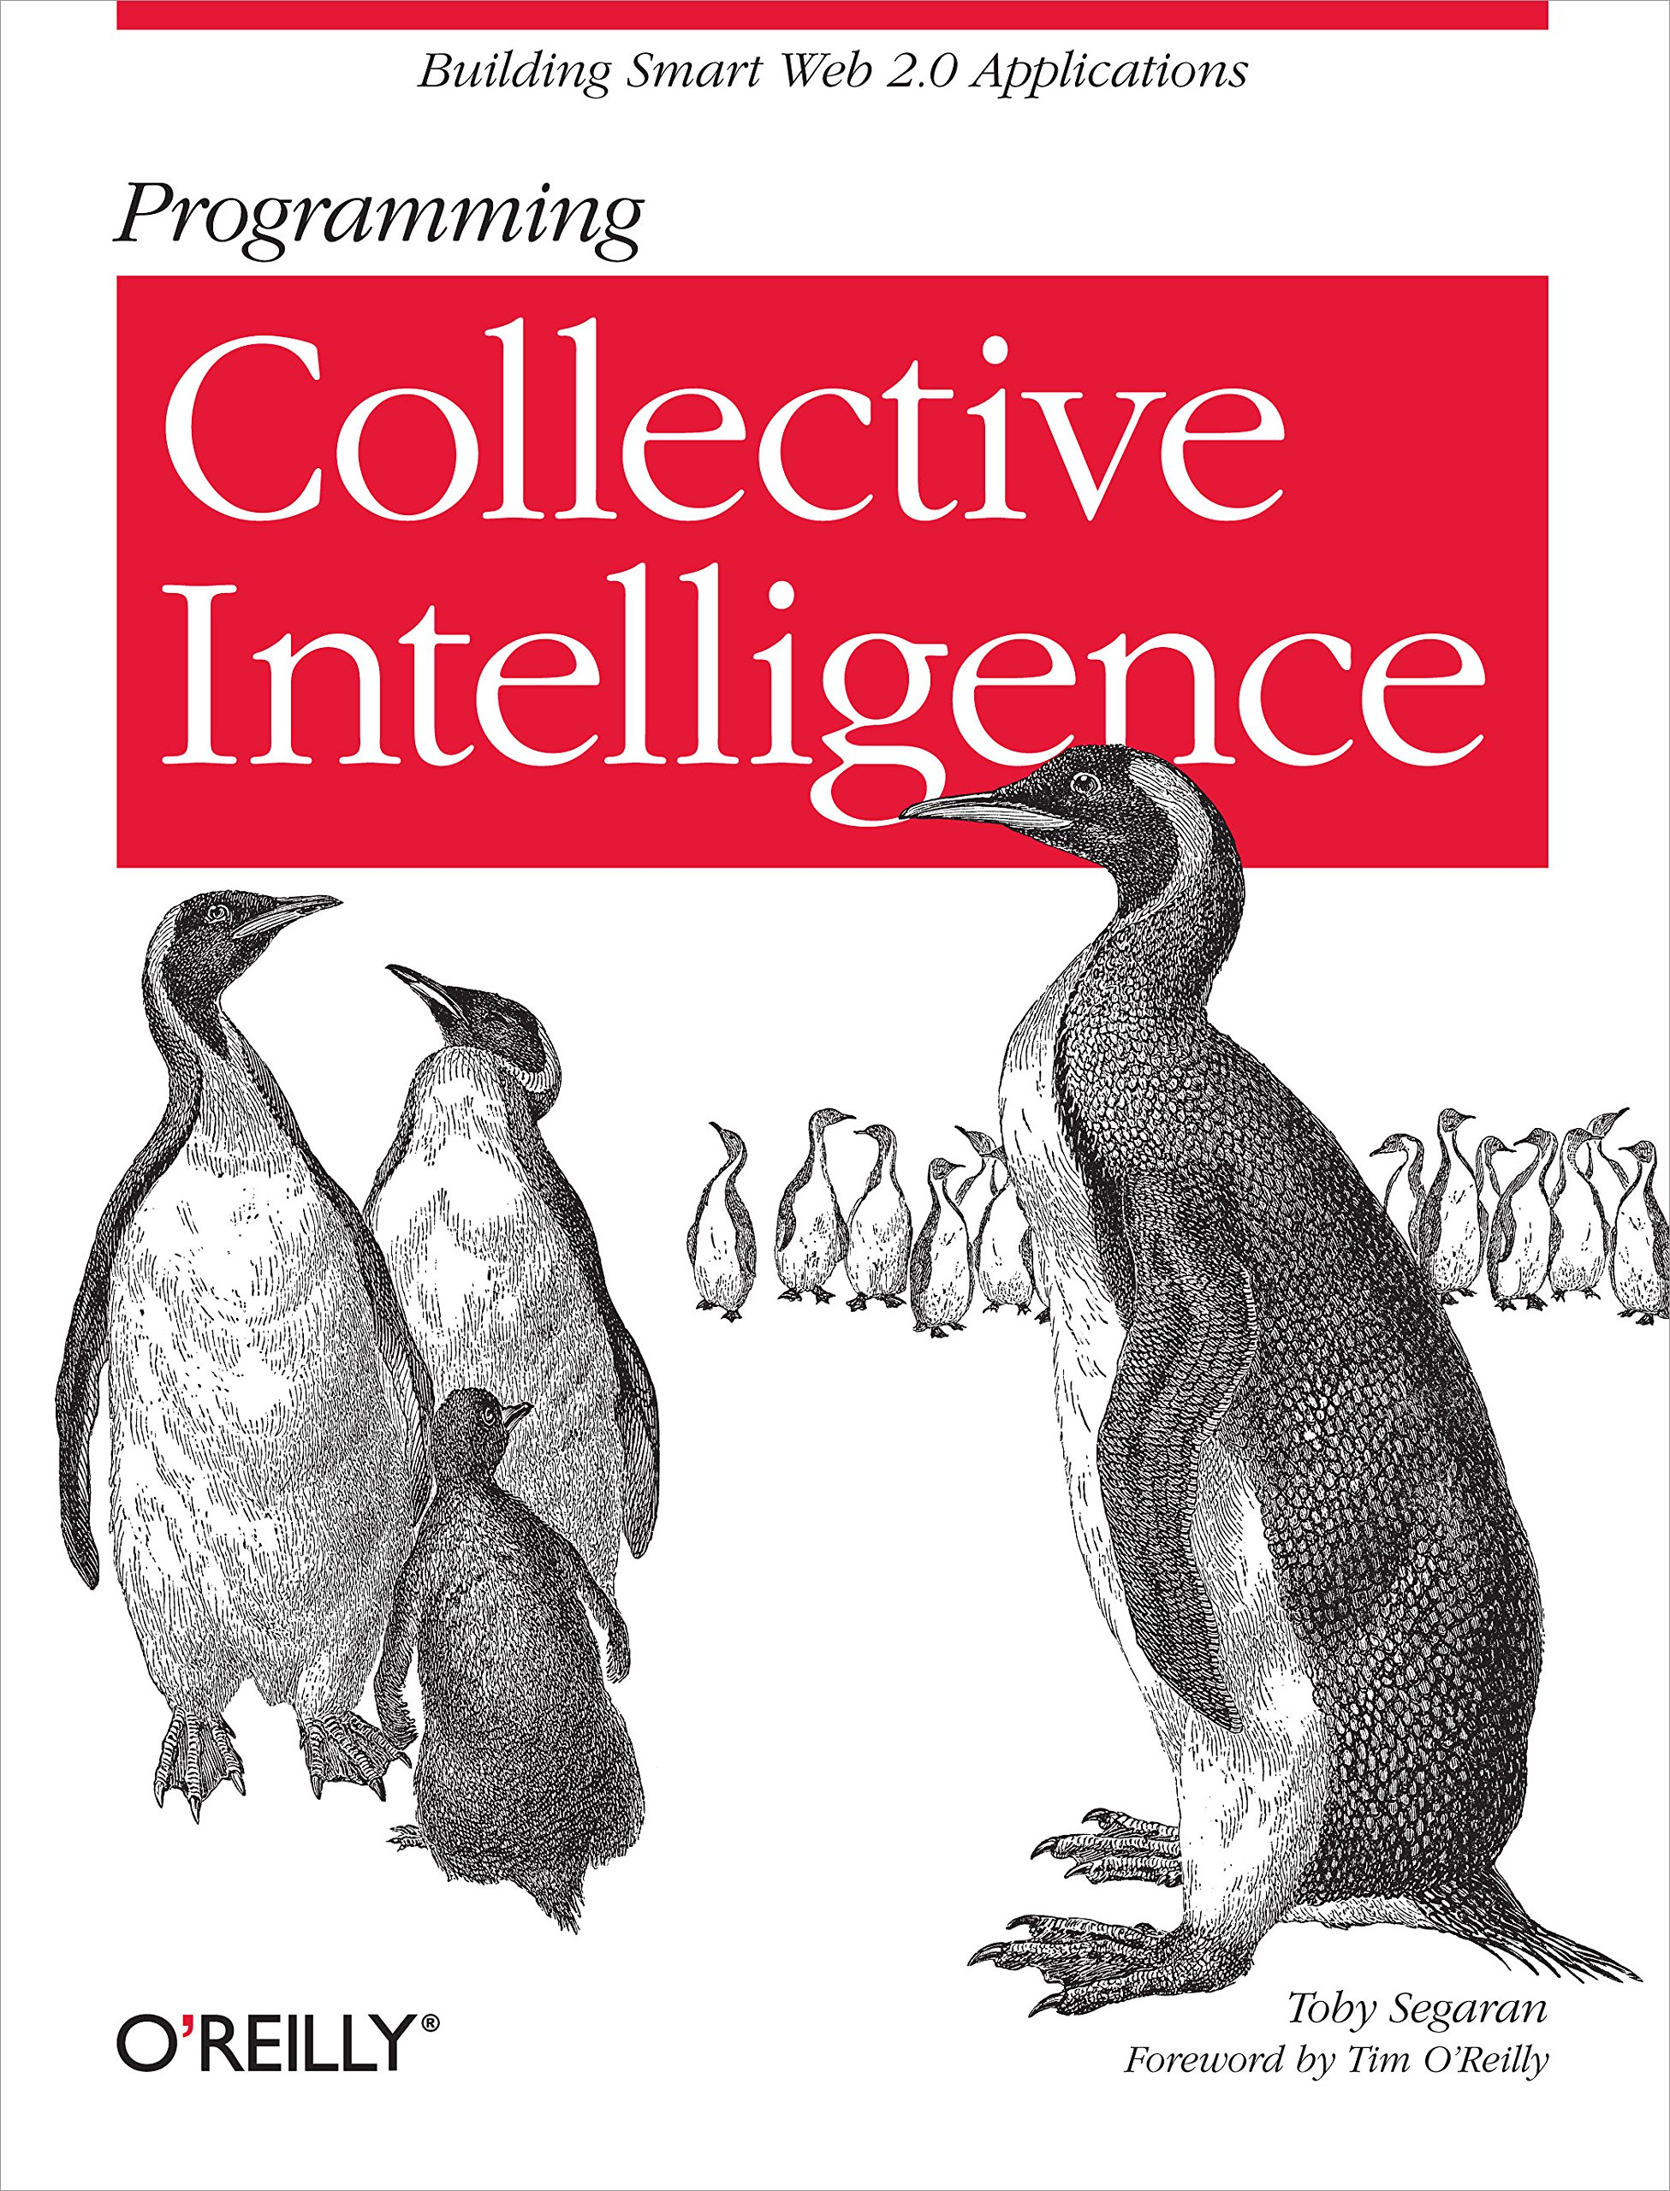
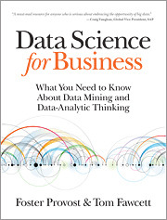
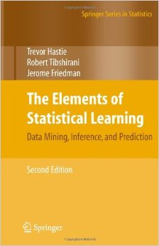
Reading Material Read, Understand and Apply
An Introduction to Statistical Learning with Application in R, by Robert Tibshirani, Trevor Hastie, Gareth James and Daniela Witten
Programming Collective Intelligence, by Toby Segaran
Data Science For Business, by Foster Provost and Tom Fawcett
The Elements of Statistical Learning, by Jerome H. Friedman, Robert Tibshirani, and Trevor Hastie

Slide 71
Other Online Resources Data Science Communities
DataTau (@__DataTau__)
Lets users share links to various Data science related resources, tutorials and projects.
http://www.datatau.com
Simply Statistics (@simplystats)
R-Blog
http://simplystatistics.org/
R – Bloggers (@Rbloggers)
R-Bloggers.com is a central hub (e.g. A blog aggregator) of content collected from bloggers who write about R (in English). Twitting blog posts from the R blogosphere
http://www.r-bloggers.com/
Other Newsletters
KD Nuggets News
Data Science Central
Data Science Weekly
R Bloggers
Analytics Vidhya
Machine Learning Mastery
Get Started and Kick-Ass in Machine Learning. Clear advice to help you start and practice applied Machine Learning – fast!
http://machinelearningmastery.com/
/

Slide 72
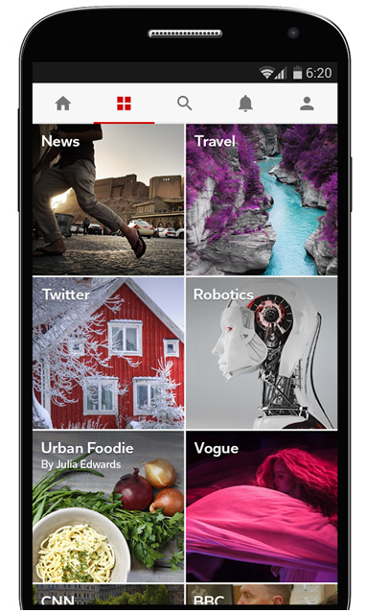
Staying Up To Date Get the latest Data Science News
Machine Learning
Algorithms
Probability
Data Mining
Search Engine Optimization
Computer Science
Natural Language Processing
Artificial Intelligence
Big Data & Deep Learning

